Slide 1
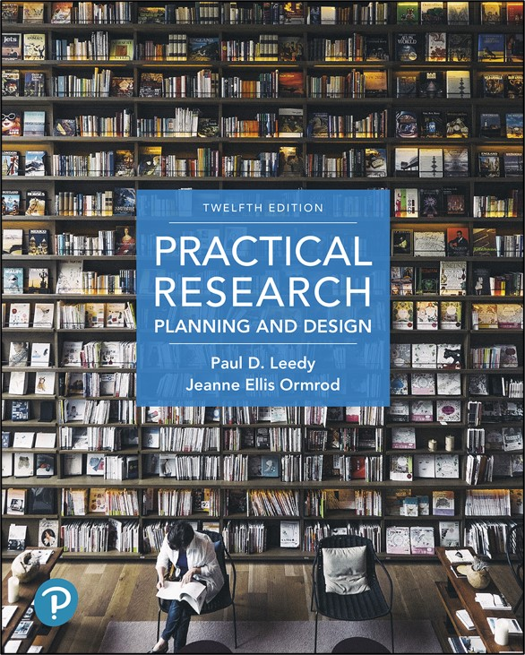
Practical Research: Planning and Design
Twelfth Edition
Chapter 1
The Nature and Tools of Research
Copyright © 2019, 2016, 2013 Pearson Education, Inc. All Rights Reserved
Notes:
If this PowerPoint presentation contains mathematical equations, you may need to check that your computer has the following installed:
1) Math Type Plugin
2) Math Player (free versions available)
3) NVDA Reader (free versions available)

Slide 2
Research is (1 of 2)
NOT merely:
gathering information.
rummaging around for hard-to-locate information.
transporting facts from one location to another.
“Research” is a word that is used loosely in everyday conversation and therefore must be defined clearly for professional use.

Slide 3
Research is (2 of 2)
A systematic process of
Collecting
Analyzing
Interpreting information (data)
Goal: increase our understanding of a phenomenon about which we are interested or concerned
Our focus is on formal research, or research intended to be communicated to a scientific community

Slide 4
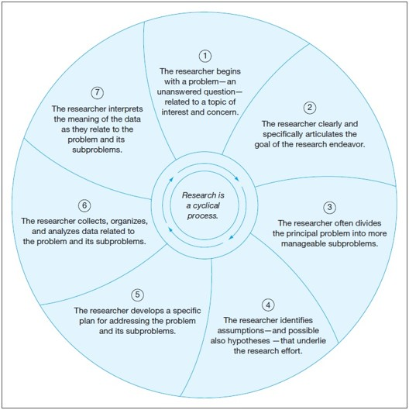
Research is a Cyclical Process
Notes:
Long Description:
The details of the diagram are as follows: the center of the diagram reads research is a cyclical process. The seven steps of the process are as follows: step 1, the researcher begins with a problem, an unanswered question, related to a topic of interest and concern; step 2, the researcher clearly and specifically articulates the goal of the research endeavor; step 3, the researcher often divides the principal problem into more manageable sub-problems; step 4, the researcher identified assumptions, and possible also hypotheses, that underlie the research effort; step 5, the researcher develops a specific plan for addressing the problem and its sub-problems; step 6, the researcher collects, organizes, and analyses data related to the problem and its sub-problems; and step 7, the researcher interprets the meaning of the data as they relate to the problem and its sub-problem.

Slide 5
Iterative Steps
Identify a question or problem (unanswered question)
Articulate a goal
Divide the principal problem into more manageable subproblems
Identify hypotheses and assumptions
Develop a specific plan
Collect, organize, and analyze data
Interpret the data as they relate to the problem

Slide 6
Assumption
An assumption is: Condition that is taken for granted.
Two general assumptions that underlie most research projects:
The phenomenon under investigation is somewhat lawful and predictable.
Cause-and-effect relationships can account for certain patterns observed in the phenomenon.

Slide 7
Hypothesis (1 of 2)
A hypothesis is:
A logical supposition
A reasonable guess
An educated conjecture
Provides a tentative explanation for a phenomenon under investigation
May direct thinking to possible sources of information necessary to resolve the research problem and its subproblems

Slide 8
Hypothesis (2 of 2)
Hypotheses are not unique to research. Just imagine any time you’ve made a “guess” about the cause of some phenomenon.
Hypotheses that are proposed prior to any data collection are called a priori hypotheses.

Slide 9
Types of Research
Quantitative Research
Involves looking at amounts, or quantities, of one or more variables of interest
Qualitative Research
Involves looking at characteristics, or qualities, that cannot be entirely reduced to numerical values
Mixed Method Research
Uses a combination of quantitative and qualitative methods
Action Research
Focused on outcomes for the practitioner

Slide 10
Philosophical Orientations Toward Research (1 of 3)
Positivism
with appropriate measurement tools, scientists can objectively uncover absolute, undeniable truths about cause-and-effect relationships within the physical world and human experience.
Postpositivism
true objectivity in seeking absolute truths can be an elusive goal and researchers bring biases to their work.

Slide 11
Philosophical Orientations Toward Research (2 of 3)
Constructivism
no absolute truth — the “realities” researchers identify are simply human-created perceptions and interpretations.
Phenomenology
focus is entirely on how human beings experience themselves and their world as they go through life.

Slide 12
Philosophical Orientations Toward Research (3 of 3)
Pragmatism/realism
absolute truths may actually exist—even if they are exceedingly difficult to discover.
human beings’ self-constructed beliefs about phenomena are legitimate objects of study in their own right.

Slide 13
Tools of Research
Specific mechanisms or strategies used to collect, manipulate, or interpret data
The library and its resources
Computer technology
Measurement
Statistics
Language
The human mind
Methodology dictates the tools the researcher selects

Slide 14
Library and its Resources
Access to books, microforms, C Ds, D V Ds, online databases
Fast and efficient means of locating and accessing information
Access to library holdings around the world

Slide 15
Computer Technology is Used for
Generating and organizing ideas
Scheduling, structuring, and coordinating projects
Finding literature
Networking with others
Storing and analyzing data
Writing, editing, formatting
Producing graphics
Presenting results

Slide 16
Measurement
Usually used in quantitative research
More difficult for qualitative research
Common instruments
Scales
Rulers
Stopwatches
Specialized instruments
Telescope
M R I

Slide 17
Main Functions of Statistics
Describe the data
Descriptive statistics summarize the general nature of the data obtained
Draw inferences from the data
Inferential statistics help the researcher make decisions about the data

Slide 18
Language as a Tool
Allows us to communicate and think more effectively
reduces complexity of the world
allows abstraction of the environment
enhances the power of thought
facilitates generalizations and drawing inferences

Slide 19
Communicating Effectively through Writing (1 of 2)
Be specific and precise: Say exactly what you mean
Keep your primary objective in mind at all times
Provide an overview of what you will be discussing
Organize ideas into categories by using headings and subheadings
Use concrete examples to make abstract ideas more understandable

Slide 20
Communicating Effectively through Writing (2 of 2)
Use figures and tables
Regularly summarize what you’ve said
Anticipate having to write multiple drafts
Check your final draft
Grammar
Punctuation
Spelling

Slide 21
Using the Tools in Word-Processing Software (1 of 2)
Beyond the basic tools of word-processing software, the following are also quite helpful:
Outlining
Setting headers and footers
Creating tables
Inserting graphics
Creating footnotes
Using international alphabets and characters
Tracking changes

Slide 22
Using the Tools in Word-Processing Software (2 of 2)
General recommendations for using a word-processor effectively:
Save and backup your document frequently.
Use spell checker and grammar checker but don’t rely on them exclusively
Print out a paper copy for final proofreading and editing

Slide 23
The Human Mind (1 of 5)
The most important tool in the researcher’s toolbox
Used for critical thinking
Evaluates
Accuracy
credibility
worth of information
lines of reasoning

Slide 24
The Human Mind (2 of 5)
Evaluation may take a variety of forms:
verbal reasoning
argument analysis
probabilistic reasoning
decision making
hypothesis testing

Slide 25
The Human Mind (3 of 5)
Deductive logic
Begins with one or more premises, statements or assumptions that the researcher initially takes to be true
Valuable for generating research hypotheses and testing theories
Inductive reasoning
Begins with an observation (sample)
Observation then used to draw conclusions about entire classes of objects or events (population)

Slide 26
The Human Mind (4 of 5)
Scientific method
Process of collecting & analyzing data systematically
Involves thinking actively and intentionally
Yields hypotheses
Theory Building
An organized body of concepts and principles
Intended to explain a particular phenomenon

Slide 27
The Human Mind (5 of 5)
Collaboration with other minds
Increases variety of
Perspectives
Backgrounds
Areas of expertise
May reduce bias

Slide 28
Exploring Research in Your Field
Juried (or refereed) research report
Judged by experts in the field and deemed to be of sufficient quality and importance to warrant publication.
Nonjuried (or nonrefereed) report
Appears in a journal or on the Internet without having been reviewed or selected by experts.
Some nonjuried reports are excellent, but others may not be.

Slide 29

Copyright
This work is protected by United States copyright laws and is provided solely for the use of instructors in teaching their courses and assessing student learning. Dissemination or sale of any part of this work (including on the World Wide Web) will destroy the integrity of the work and is not permitted. The work and materials from it should never be made available to students except by instructors using the accompanying text in their classes. All recipients of this work are expected to abide by these restrictions and to honor the intended pedagogical purposes and the needs of other instructors who rely on these materials.

